Slide 1
SMART STICK FOR BLIND PEOPLE
MEMBERS OF THE TEAM:
GANGAM ANUSHA
PALADI BHAVYA
B.KARTHIK GOUD
M.MEGHANA

Slide 2
INTRODUCTION:
In order to improve the safety of visually challenged users and enhance their awareness of their surroundings while navigating in outdoor environment, a smart device is needed.
In this paper, a smart walking stick for the visually challenged has been presented.
The proposed device can detect obstacles as well as terrain changes in the user's path.
The overall design of the device ensures accuracy, energy efficiency and easy portability

Slide 3
HARDWARE COMPONENTS:
>ESP32
>Ultrasonic Sensor >Buzzer >Breadboard
>Jumpers
SOFTWARE USED:
>Arduino IDE

Slide 4
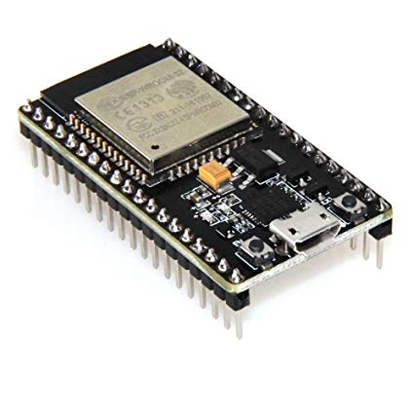
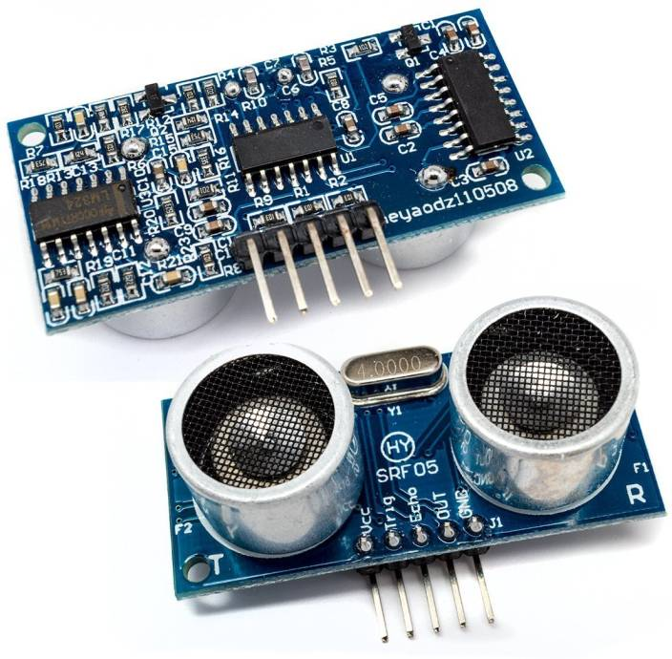
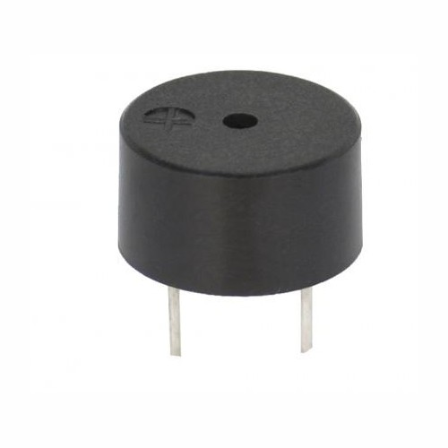
ESP32
ESP32 is a series of low cost , low power on a chip microcontrollers
with integrated Wi-Fi and dual mode Bluetooth
Ultrasonic sensor
Ultrasonic sensors measure distance by using ultrasonic waves.
The sensor head emits an ultrasonic wave and receives the
wave reflected back from the target. Ultrasonic Sensors
measure the distance to the target by measuring the time
between the emission and reception.
BUZZER
A buzzer or beeper is an audio signalling device,Typical uses of buzzers
and beepers include alarm devices, timers, and confirmation of user
input such as a mouse click or keystroke.

Slide 5
BLOCK DIAGRAM :
ESP32
POWER SUPPLY
ULTRASONIC
SENSOR 1
BUZZER
ULTRASONIC
SENSOR 2

Slide 6
METHODOLOHY :
The working behind this blind stick is that it is used for special purpose as a sensing device for the blind people .It is widely used to detect objects using ultrasonic sensor.
If any object is present, the ultrasonic sensor detects the objects by measuring the distance between the object and the user.
Here two ultrasonic sensors are used to detects the objects ,one of the ultrasonic sensor is used to detect the lower objects and other one sensor is used to detect the upper object and sends data to ESP32 development board.
To determine the distance of an object , calculate the distance between sending the signal and receiving back the signal.
The distance is calculated as below :
Distance=Duration*0.034/2
When the object is detected the Buzzer/Alram will be activated

Slide 7
Applications:
Sensor and signal processing based technologies are recently using for the mobility of blind people . To assist the blind people a smart walking stick is designed in such a way that the stick operates just like a radar system that uses ultrasonic sonar sensor to identify the fixed and moving objects

Slide 8
ADVANTAGES:
It does help users with visual impairments to find obstacles at head or knee level.
To overcome these difficulties, smart canes with alerts and extended obstacle detection range have been introduced.
Easily accessible.

Slide 9
Conclusion:
The main purpose of this study is to produce a prototype that can detect objects or obstacles in front of users and feeds warning back, in the forms of voice messages and vibration, to users. Combination of ultrasonic sensors and a microcontroller function for detection and distance stick and obstacles in front of. This project is helpful to people with disabilities who are blind to facilitate the movement and increase safety.

Slide 10
Thank you

